Slide 1
Sentiment Analysis Using multinomial naïve bayes model
INFO 523
Final Project
Pureum Kim

Slide 2





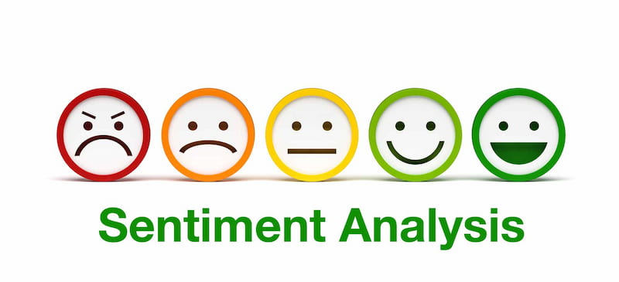
Background
(Hint: Multinomial Naïve Bayes Model)

Slide 3
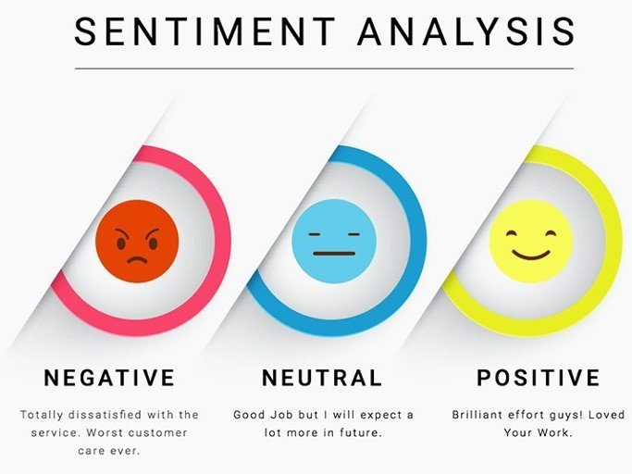
What Is Sentiment Analysis?
Purpose: classify the emotion expressed in a given text
Computational task of automatically determining what feelings a writer is expressing in text
Often framed as a binary distinction (positive vs. negative)
Can also be a more fine-grained, like identifying the specific emotion an author is expressing (like fear, joy, or anger)

Slide 4
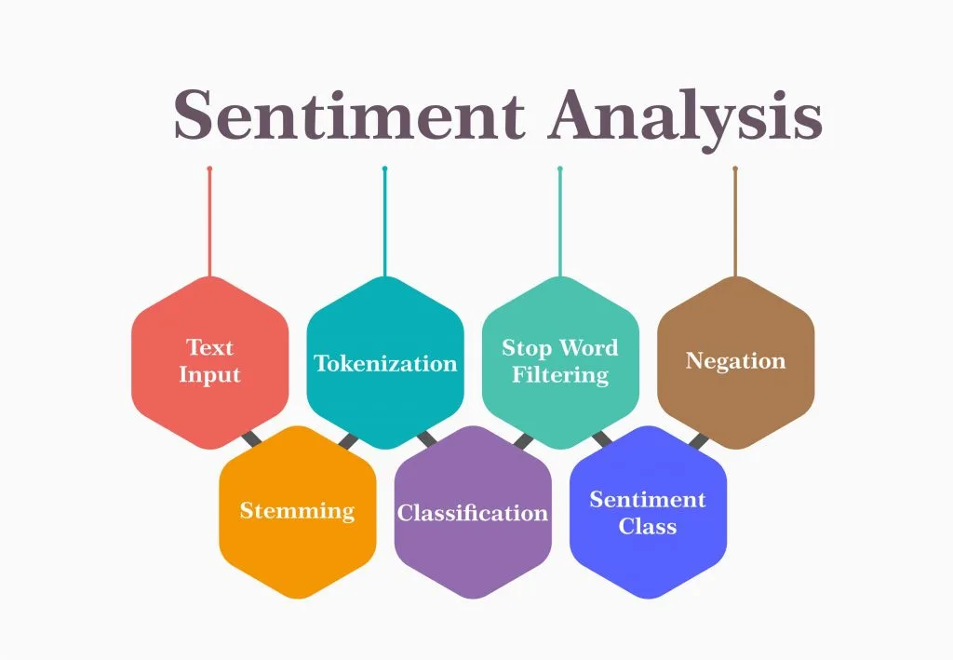
Three Approaches to Sentiment Analysis
Lexicon based
Dictionary-based: Use a dictionary of terms, such as SentiWordNet and WordNet
Corpus-based: Based on statistical analysis of contents (e.g., k-NN, CRF, HMM, etc.)
Machine-learning based
Traditional
Deep-learning
Hybrid
Lexicon + machine learning
Lexicons often play a key role

Slide 5
How Does It Work? – Machine Learning
Step 1
Step 2
Step 3
Step 4
Clean data
Split into individual words
Numerical vectors
Word embedding
TF-IDF
Stop words, non-characters, etc.
lemmatization
Analyze

Slide 6
Multinomial Naïve Bayes Model
Bayesian learning approach popular in NLP
Guesses the tag of a text using Bayes theorem
Made up of a number of algorithms that all have one thing in common: each feature being classed is unrelated to any other feature. A feature's existence or absence has no bearing on the inclusion or exclusion of another feature.
P(A|B) = P(A) * P(B|A)/P(B)

Slide 7
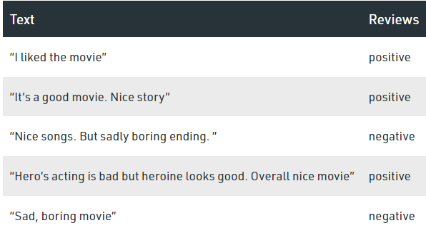
Multinomial Naïve Bayes Model
Training Dataset:
Classify:
“overall liked the movie”
Calculate
P(positive | overall liked the movie) — the probability that the tag of a sentence is positive given that the sentence is “overall liked the movie”. P(negative | overall liked the movie) — the probability that the tag of a sentence is negative given that the sentence is “overall liked the movie”.

Slide 8
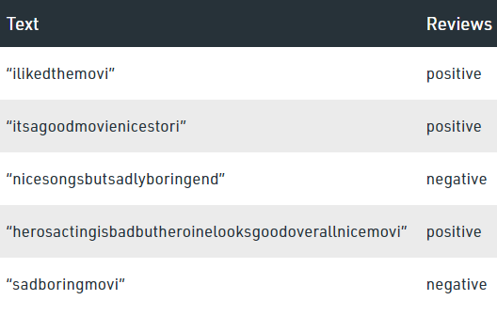
Multinomial Naïve Bayes Model
Training Dataset:
Beforehand:
Removing stop words
stemming

Slide 9
Multinomial Naïve Bayes Model
“overalllikedthemovie” (not in training data)
P(overall liked the movie | positive)* P(positive) with P(overall liked the movie | negative) * P(negative)
P(overall liked the movie) = P(overall) * P(liked) * P(the) * P(movie)
P(overall liked the movie| positive) = P(overall | positive) * P(liked | positive) * P(the | positive) * P(movie | positive)
P(overall | positive) * P(liked | positive) * P(the | positive) * P(movie | positive) * P(positive) = 1.38 * 10^{-5} = 0.0000138
P(overall | negative) * P(liked | negative) * P(the | negative) * P(movie | negative) * P(negative) = 0.13 * 10^{-5} = 0.0000013

Slide 10
Multinomial Naïve Bayes Model
Advantages
Disadvantages
Low computation cost
It can effectively work with large datasets
For small sample sizes, Naive Bayes can outperform other alternatives
Easy to implement, fast and accurate method of prediction
Can work with multiclass prediction problems
It performs well in text classification problems
Not suitable for regression
Cannot be used for numerical values
Can be less accurate compared to other models

Slide 11






Real-World Applications
Analyzing the social media discussion around a certain topic
Evaluating survey responses
Determining whether product/service reviews are positive or negative

Slide 12
How This Relates to Topics in Class
Part of data mining and machine learning
Calculation using probability
Taking a large set of data to make predictions
Supervised technique for classification
Labeled datasets (“training”)
Model can measure its accuracy and can learn over time

Slide 13
A worked example in R +Github Repo
Github link: https://github.com/pkim93/INFO523

Slide 14
Conclusions, Recommendations, and Future Work
Conclusion
Supervised machine learning technique
Can be used to identify emotion expressed in a text
Useful for businesses to find out what the consumers are thinking about
Recommendations
Find the best model (e.g., XLNet, BERT) before analysis
Nuances
Prevent biases
Future Work
Move beyond restaurant reviews
Sarcasm
Humor
Political Twitter and sentiment analysis, retweet, and network analyses

Slide 15
Thanks!

